Slide 1

The Benefits and Costs of Taxation
More children are born in late December than in early January, and the extra births appear to be clustered among those who have the most to gain from a tax deduction.
Unless you’re a cynic, or an economist, I realize you might have trouble believing that the intricacies of the nation’s tax code would somehow affect something as sacred as the birth of a child.
But it appears that you would be wrong.
— David Leonhardt, The New York Times

Slide 2

INCOME TAX
The structure of the U.S. income tax system
Tax Brackets over Time
Marginal Tax Rate and Effective Tax Rate
The difference between progressive and regressive taxes
the trade-off between tax equity and tax efficiency
To First
Active Learning
To Video

Slide 3
Two Principles of Tax:
Two principles of tax fairness:
1) The benefits principle: Those who benefit from public spending should bear the burden of the tax that pays for that spending. Ex: 520 toll fee, the diamond lane fee
2) The ability-to-pay principle: Those with greater ability to pay a tax should pay more tax.
Ex: a progressive income tax, larger vehicles pay more toll fee
There is usually a trade-off between equity and efficiency: The system can be made more efficient only by making it less fair, and vice versa,
more fair, but less efficient.

Slide 4
Understanding the Tax System
Some important taxes and terms:
Lump-sum tax is the same for everyone, regardless of any actions people take.
Income tax depends on income from wages and investments
(except for 7 states: WA, AK, FL, NV, SD, TX, WY).
Payroll tax depends on the earnings an employer pays to an employee (=Social Security Tax).
Payroll = FICA = Social Security (OSDI) + Medicare (6.2% + 1.45%)
OSDI: Old-age, Survivors, and Disability Insurance
FICA = Federal Insurance Contributions Act (1938, President FDR)
Sales tax depends on the value of goods sold
(except for 5 states: OR, AK, DE, NH, MT).
Profits tax depends on a firm’s profits.
Property tax depends on the value of property, such as a home.
Wealth tax: a tax that depends on an individual’s wealth.

Slide 5
Understanding the Tax System
The tax structure specifies how the tax depends on the tax base. Two systems:
1) A progressive tax takes a larger share of the income of high-income taxpayers than of low-income taxpayers.
2) A regressive tax takes a smaller share of the income of high-income taxpayers than of low-income taxpayers.
Flat tax system (proportional tax) is adopted by some countries that are newly liberated and small in size.
The marginal tax rate is the percentage of an increase in income that is taxed away.
The effective (average) tax rate is the percentage of total tax owed as a portion of total income.

Slide 6
US Federal Income Tax: with 7 Tax Brackets
Note: The figures below are just estimates, they change year by year.
Tax Rate Single Head of Household
10% $0-8,350 0 – 11,950
15% 8,351-33,950 11,951-45,500
25% 33,951 - 82,250 45,501-117,450
28% 82,251 -171,550 117,451- 190,200
33% 171,551-372,950 190,201- 372,950
35% 372,951 -399,999 372,951 -399,999
39.6% 400,000- 400,000 -
Notes:
If your income is $25,000:
- you pay 10% for the first $8,350 = $835
- you pay 15% for the next (25,000-8350) = $2,497.50
total tax you paid: 3,332.50
as a percentage of your total income: (3,332.50/25,000).100% = 13.33%
This is your Effective tax rate or Average tax rate.
Your marginal tax rate is 15%, as you belong to the 15% tax bracket.
2. If your income is $45,000:
Your marginal tax rate is 25%, as you belong to the 25% tax bracket.
Your Average tax rate:
- you pay 10% for the first $8,350 = $835
- you pay 15% for the next (33,950-8350) = $3,840
- you pay 25% for the remaining (45,000-33,950) =$2,762.50
total tax you paid: 7,437.50
as a percentage of your total income: (7,437.50/45,000).100% = 16.53%
This is your Effective tax rate or Average tax rate.
Do the same for $75,000 income, use the Head of Household column.

Slide 7
U.S. Tax Rates since 1913 – in Perspective
History of income tax rates, adjusted for inflation
Year Brackets Rate Income Adj. 2014
1913 7 1% - 7% $500,000 $11.86M First permanent income tax
1917 21 2% -67% $2,000,000 $36.68M World War I financing
1925 23 1.50% --25% $100,000 $1.34M Post war reductions
1932 55 4% --63% $1,000,000 $17.14M Depression era
1936 31 4% --79% $5,000,000 $84.45M -
1941 32 10% -81% $5,000,000 $79.86M World War II
1942 24 19%- 88% $200,000 $2.75M Revenue Act of 1942
1944 24 23% -94% $200,000 $2.88M Individual Income Tax Act of 1944
1946 24 20% -91% $200,000 $2.41M -
1964 26 16%- 77% $400,000 $3.03M Tax reduction during Vietnam war
1965 25 14% -70% $200,000 $1.49M -
1981 16 14% -70% $215,400 $563k Reagan era tax cuts
1982 14 12% -50% $85,600 $211k Reagan era tax cuts
1987 5 11% -38.50% $90,000 $186k Reagan era tax cuts
1988 2 15% -28% $29,750 $59k Reagan era tax cuts
1991 3 15% -31% $82,150 $142k Omnibus Budget Reconciliation Act of 1990
1993 5 15% -39.60% $250,000 $406k Omnibus Budget Reconciliation Act of 1993
2003 6 10% -35% $311,950 $398k Bush tax cuts
2011 6 10% -35% $379,150 $396k -
2013 7 10% -39.60% $400,000 $403k American Taxpayer Relief Act of 2012

Slide 8
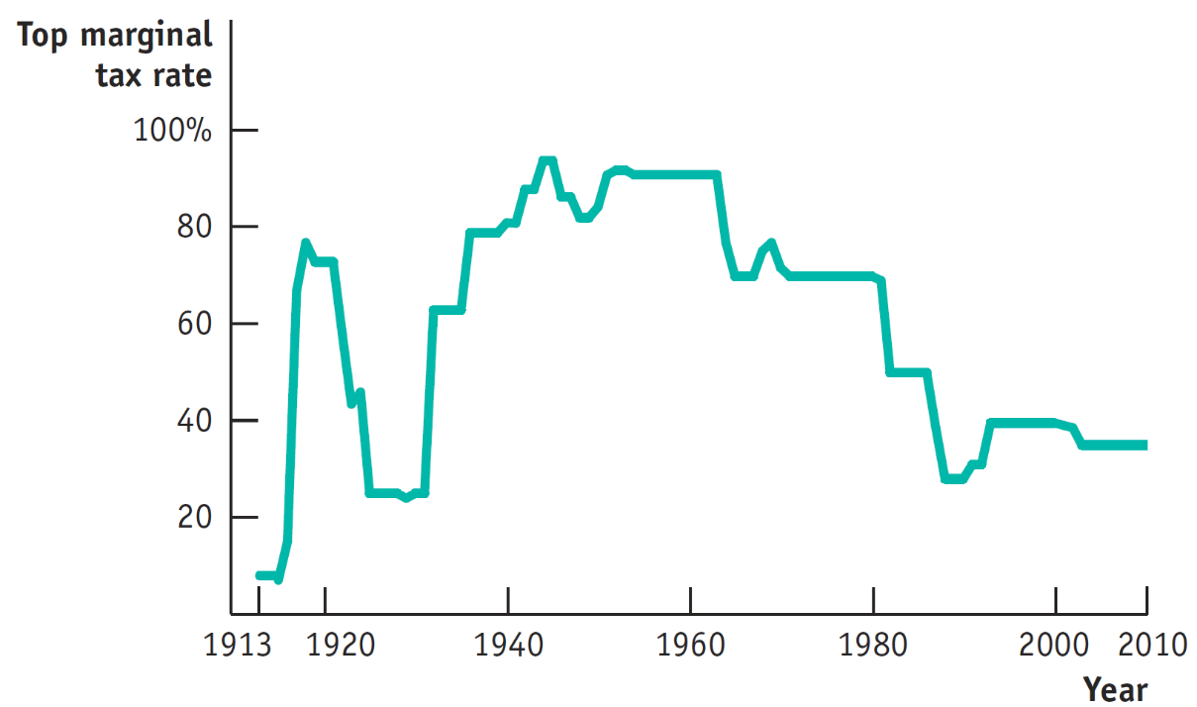
Top U.S. Marginal Income Tax Rates for 100 Years

Slide 9
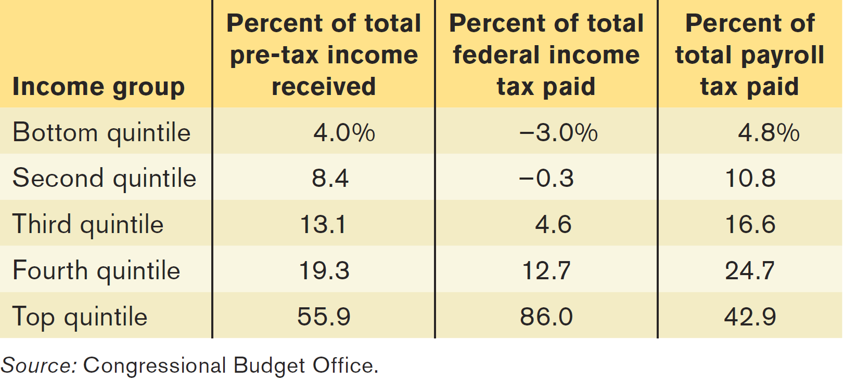
Share of Pretax Income, Federal Income Tax, and Payroll Tax by Quintile (1/5)
What do you say about “the income distribution”?
Do you notice that negative sign? What does it mean?

Slide 10
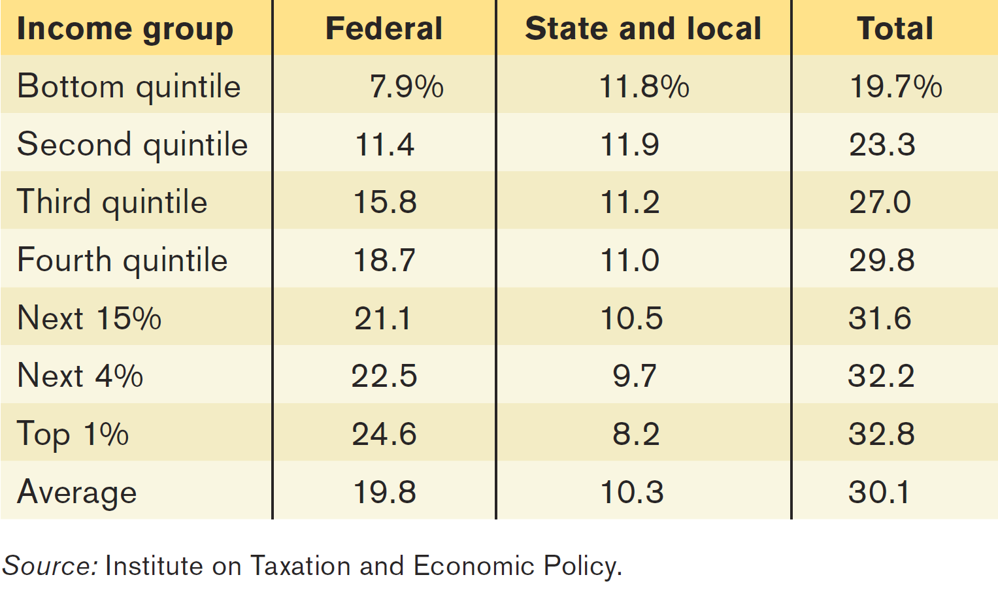
Federal, State, and Local Taxes as a Percent of Income, by Income Category
What do you say about “the income distribution” from the bottom quintile to the Top 1%?
Why are the numbers different between Federal and State?

Slide 11
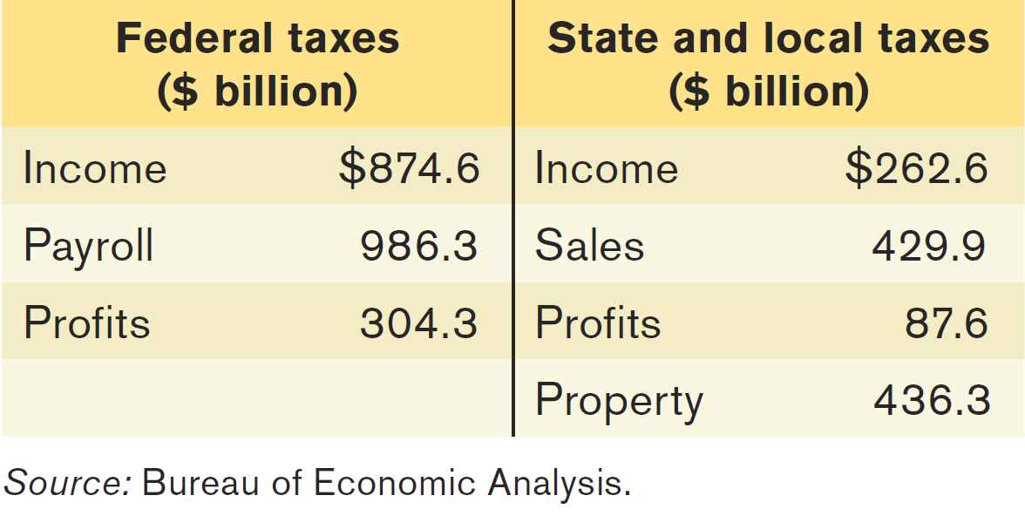
Major Taxes in the United States
Do you notice that State/Local Taxes have lower income tax revenues, and higher on
Sales Tax revenues and Property Tax revenues?

Slide 12
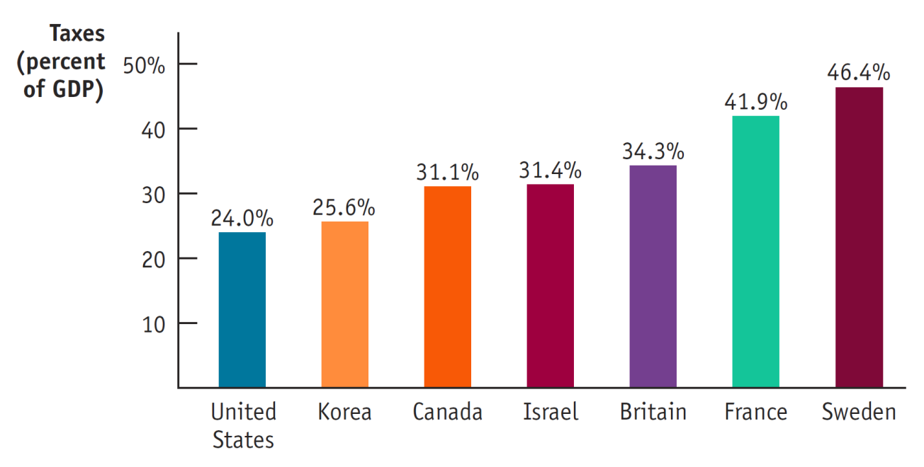
You Think You Pay High Taxes?
OECD, 2009
As a percent of total income of the country, Americans pay 24% tax.
Sweden pays 46.4% tax; what do you think justify this number?
Would you mind paying close to 50% tax?

Slide 13
US Federal Income Tax: with 7 Tax Brackets
Note: The figures below are just estimates, they change year by year.
Tax Rate Single Head of Household
10% $0-8,350 0 – 11,950
15% 8,351-33,950 11,951-45,500
25% 33,951 - 82,250 45,501-117,450
28% 82,251 -171,550 117,451- 190,200
33% 171,551-372,950 190,201- 372,950
35% 372,951 -399,999 372,951 -399,999
39.6% 400,000- 400,000 -
Using the above tax bracket, what is the marginal tax rate, the total tax paid in dollars, and the effective (average) tax rate paid for the following:
If your income is $25,000
If your income is $45,000
Nb: In reality, there are some deductions and exemptions (which was deducted to gross income, prior applying the tax rate), for example:
standard deduction ($5,700), and personal exemption ($3,650) - but let’s ignore this for now.
The above also does not include the Payroll Tax (7.65%).
Notes:
If your income is $25,000:
- you pay 10% for the first $8,350 = $835
- you pay 15% for the next (25,000-8350) = $2,497.50
total tax you paid: 3,332.50
as a percentage of your total income: (3,332.50/25,000).100% = 13.33%
This is your Effective tax rate or Average tax rate.
Your marginal tax rate is 15%, as you belong to the 15% tax bracket.
2. If your income is $45,000:
Your marginal tax rate is 25%, as you belong to the 25% tax bracket.
Your Average tax rate:
- you pay 10% for the first $8,350 = $835
- you pay 15% for the next (33,950-8350) = $3,840
- you pay 25% for the remaining (45,000-33,950) =$2,762.50
total tax you paid: 7,437.50
as a percentage of your total income: (7,437.50/45,000).100% = 16.53%
This is your Effective tax rate or Average tax rate.
Do the same for $75,000 income, use the Head of Household column.

Slide 14
In-Class Exercise
1. In Eastlandia, income between zero to $25,000 is zero-taxed, income between $25,000 and $50,000 is taxed 10%, and income over $50,000 is taxed at a rate of 20%. Calculate the average tax rate (= “effective “tax rate) of income of :
$75,000;
$125,000;
Is Eastlandia’s tax system a progressive, regressive, or flat?
Tax Rate Single Head of Household
10% $0-8,350 0 – 11,950
15% 8,351-33,950 11,951-45,500
25% 33,951 - 82,250 45,501-117,450
28% 82,251 -171,550 117,451- 190,200
33% 171,551-372,950 190,201- 372,950
35% 372,951 -399,999 372,951 -399,999
39.6% 400,000- 400,000 –
2. Using the above tax bracket, what is the marginal tax rate, the total tax paid in dollars, and the effective (average) tax rate paid for the following:
a) If your family income is $75,000
b) If your family income is $125,000

